Slide 1
Airline Reservation System Management
Batch Code: 2210G3
Faculty: Sir Salah
Co-Ordinator: Miss Hafsa Qadir
Curriculum code: 7062

Slide 2

Main Page

Slide 3
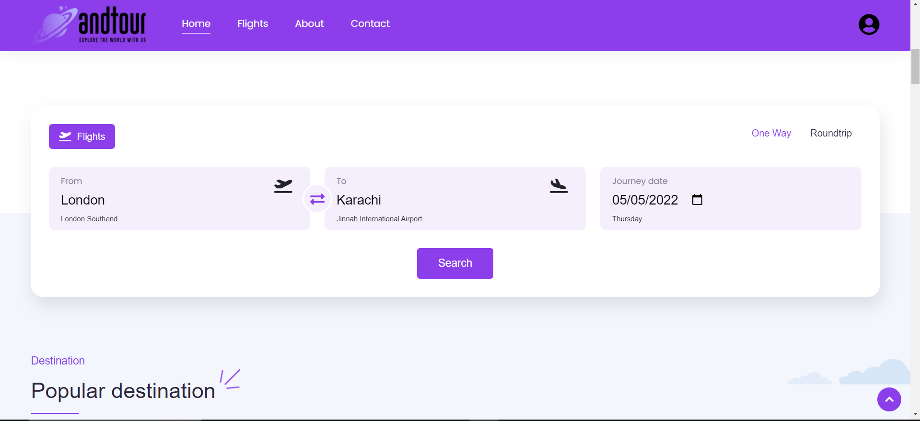
Flight Search

Slide 4
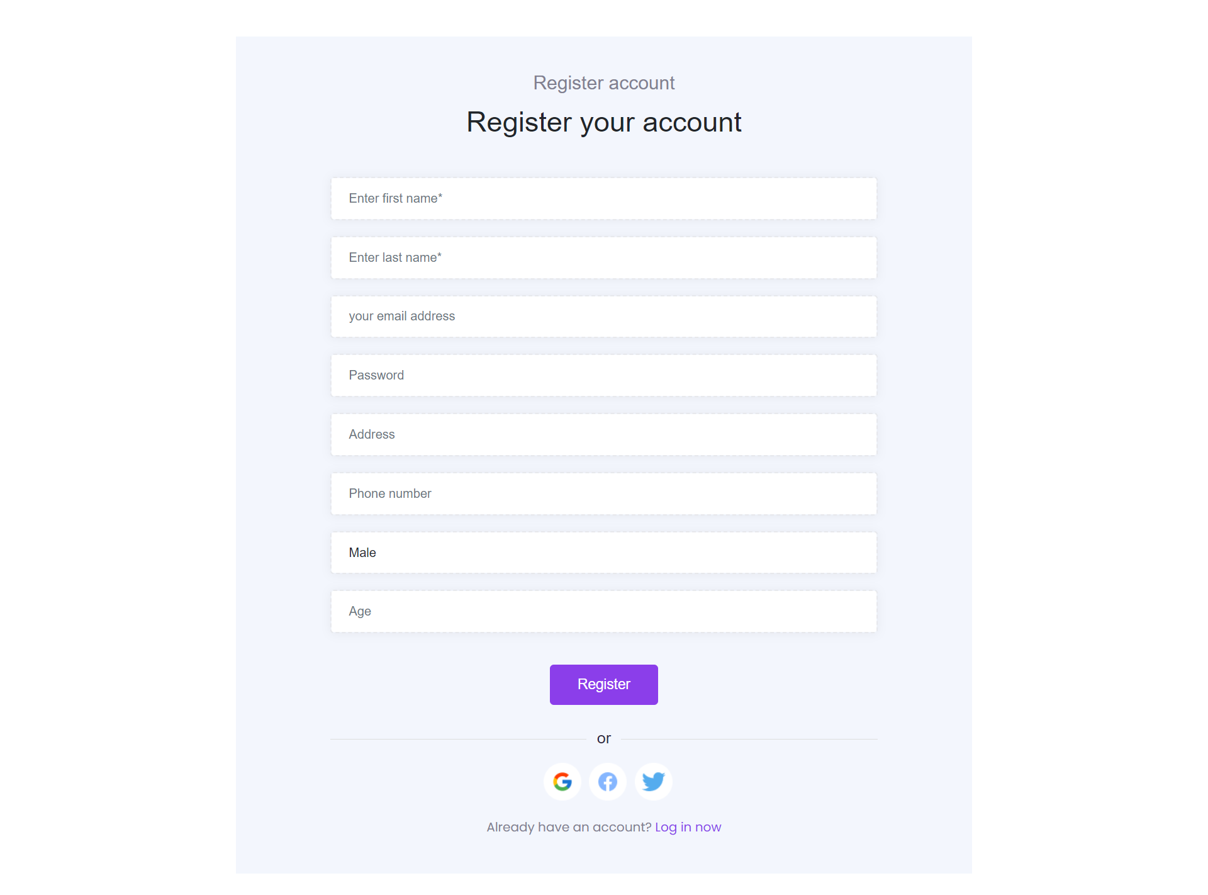
Registration Form

Slide 5
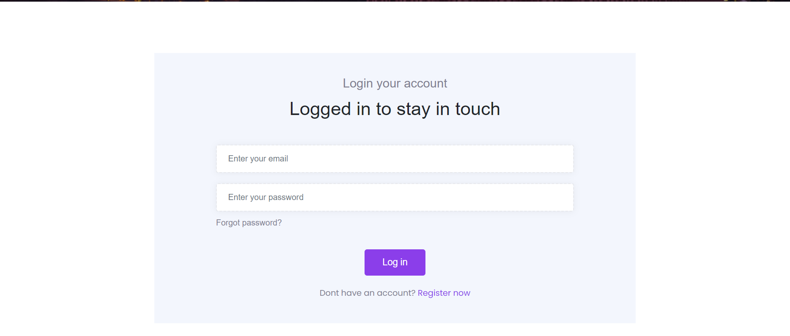
Login Form

Slide 6
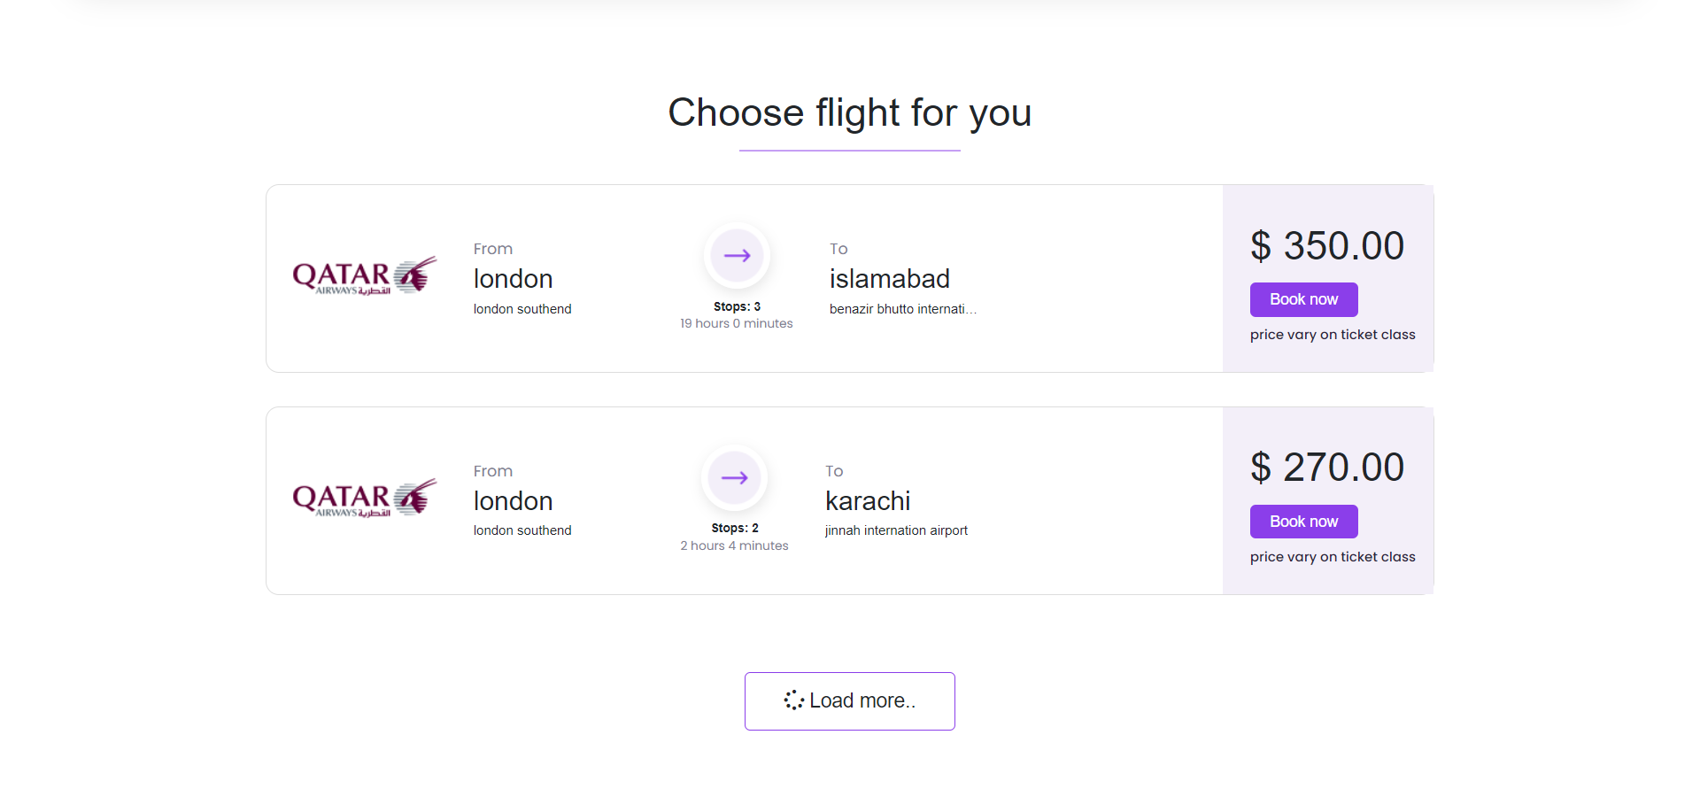
Flight Listing

Slide 7
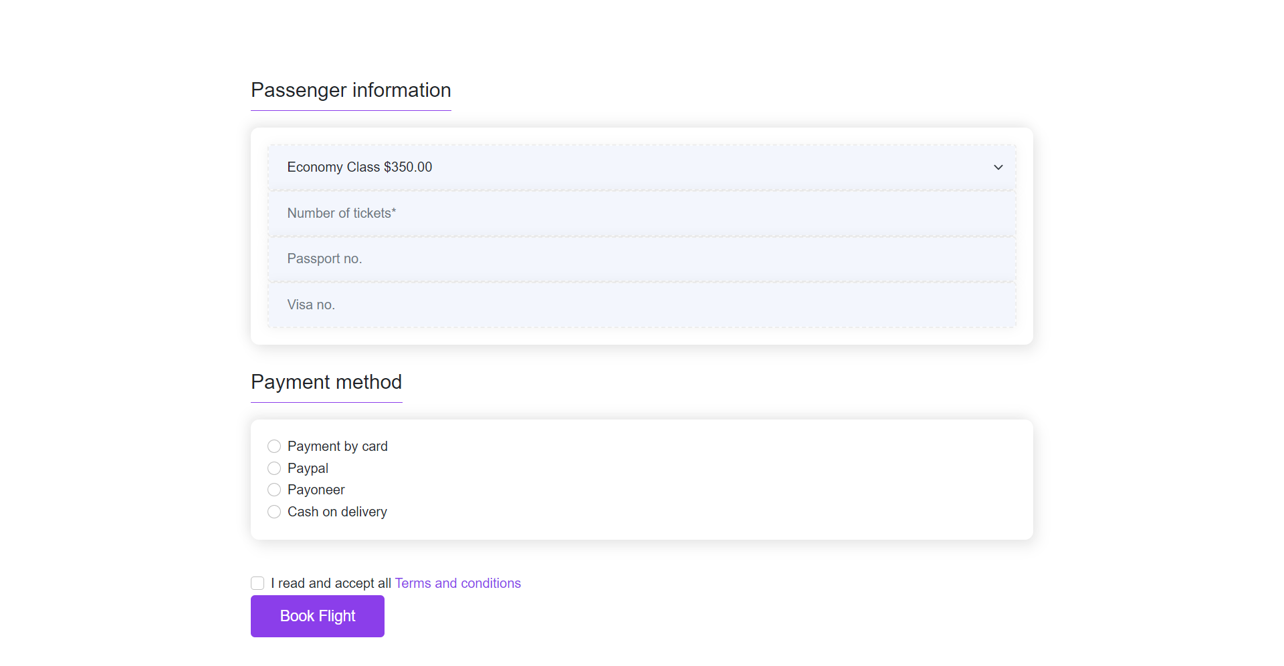
Flight Booking Form

Slide 8
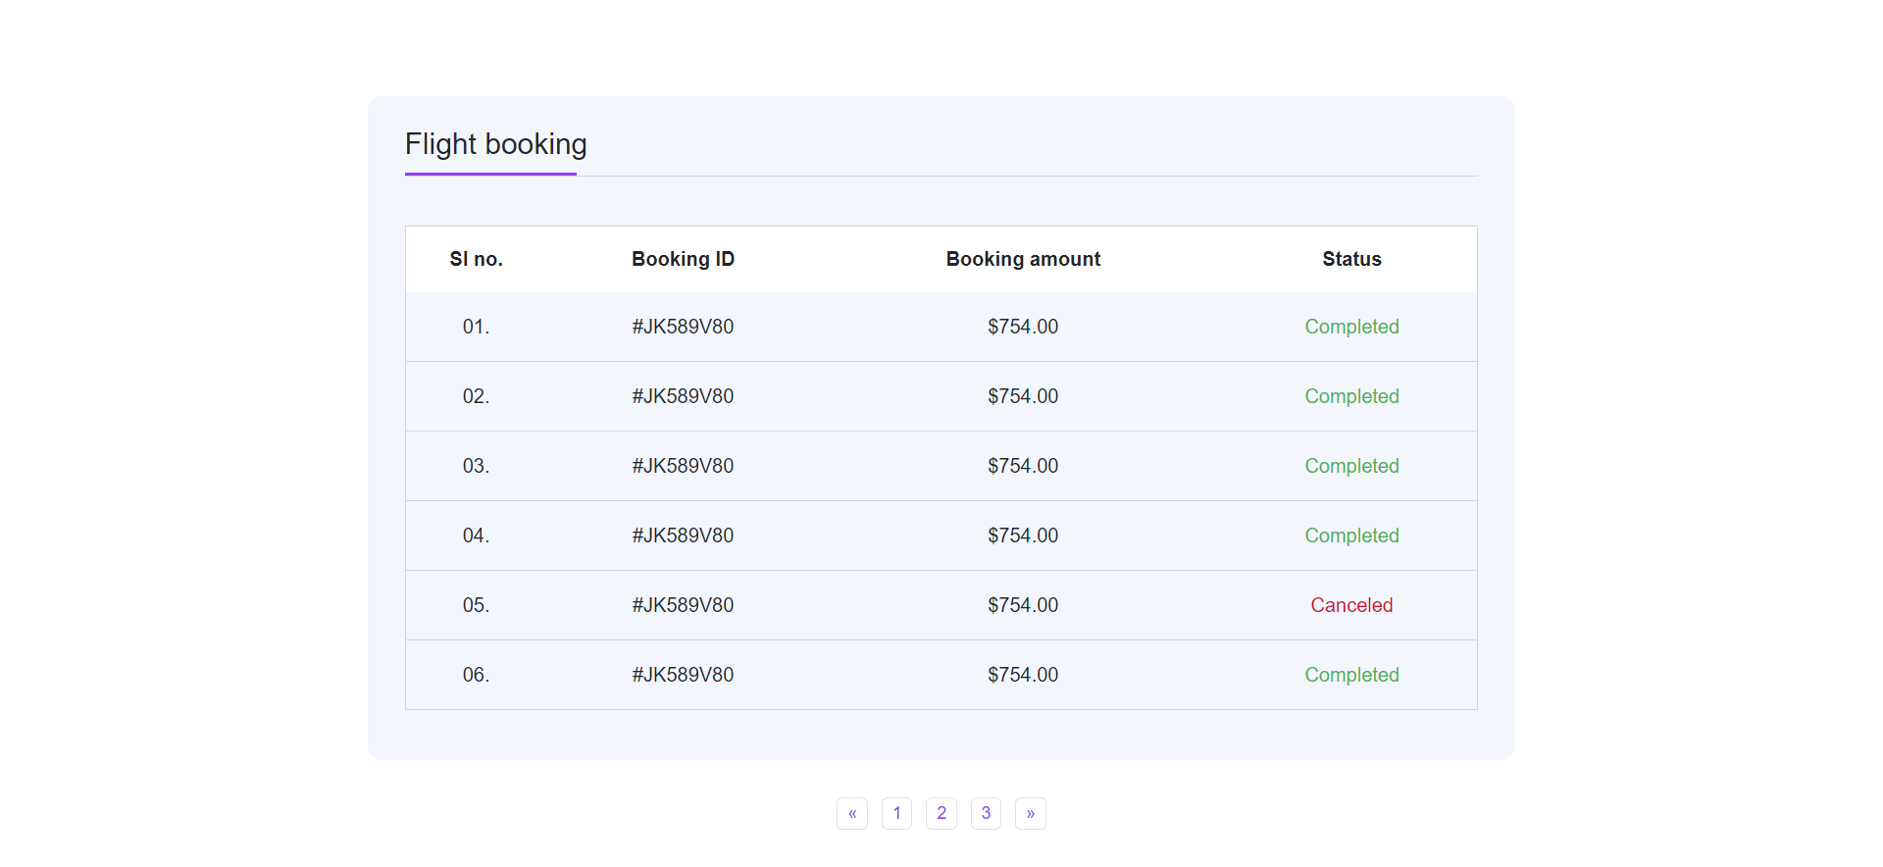
User Flights

Slide 9
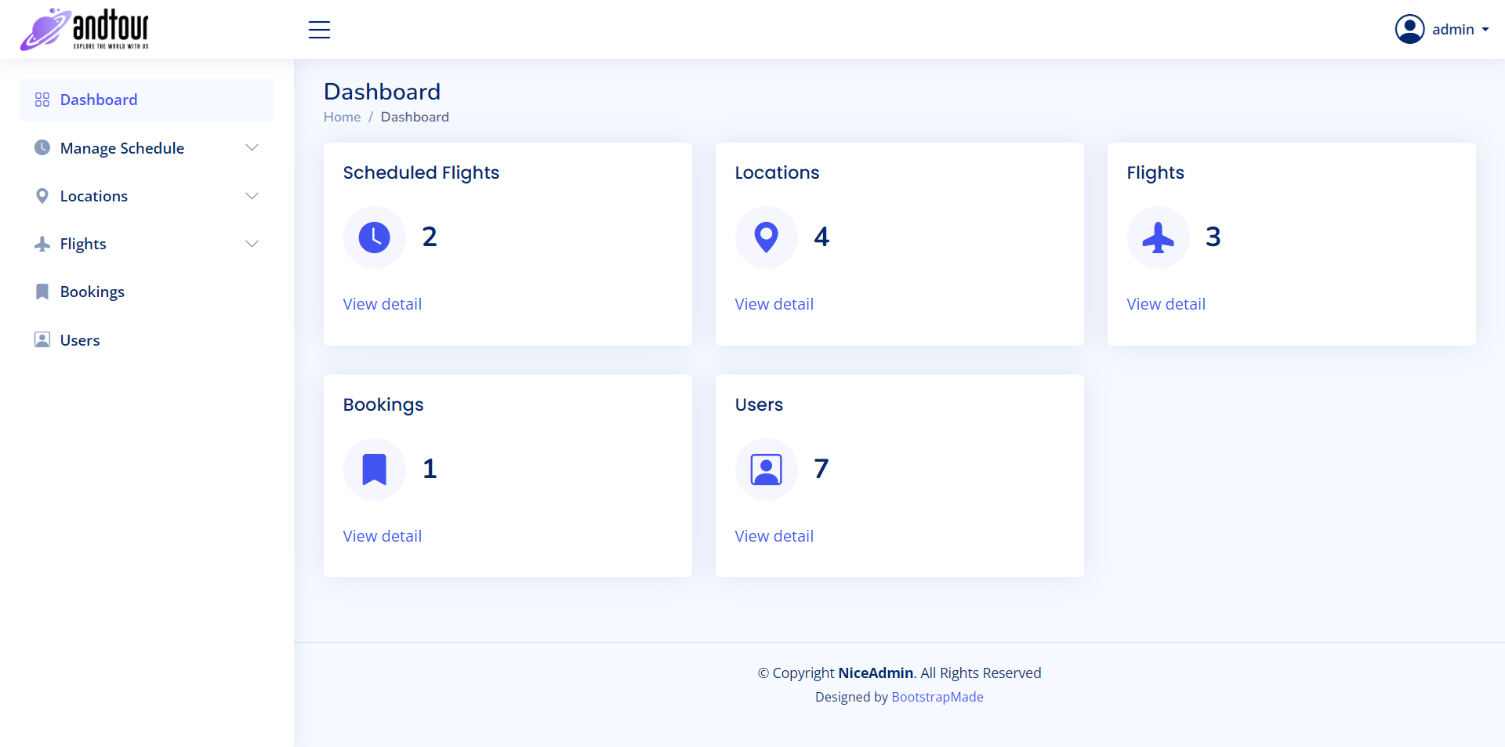
Admin Dashboard

Slide 10
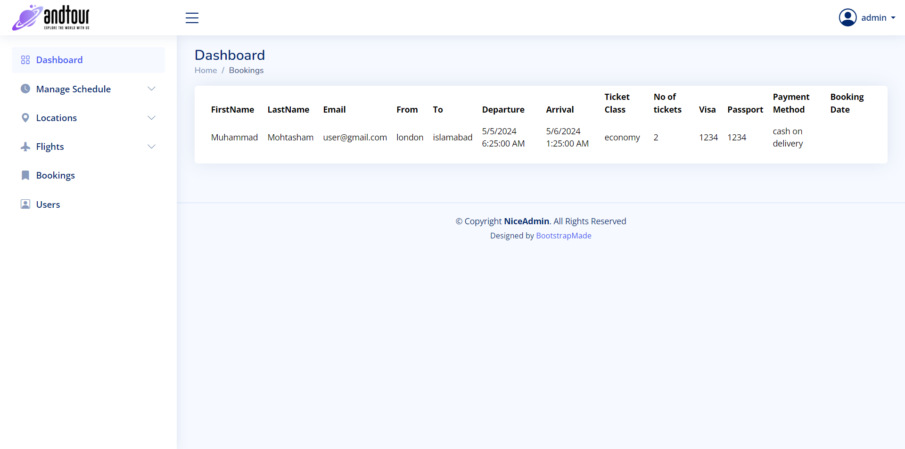
All Bookings

Slide 11
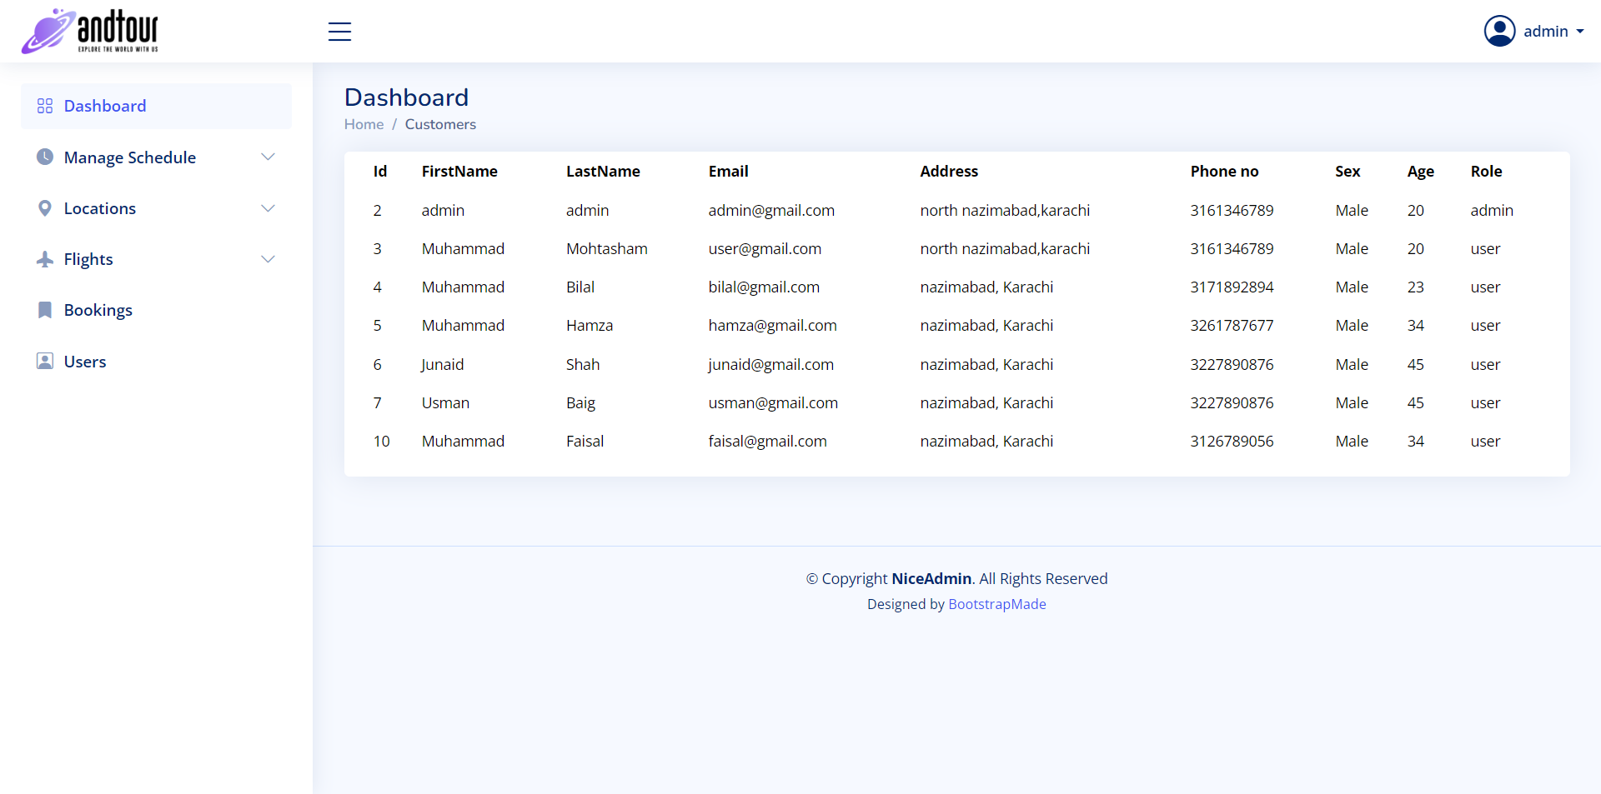
Registered Users

Slide 12
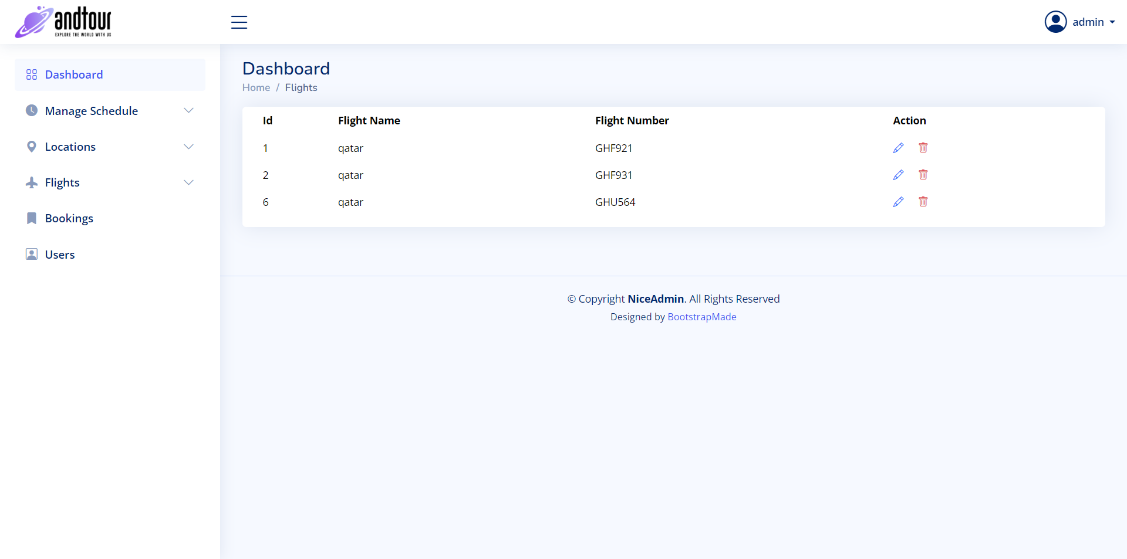
All Flights

Slide 13
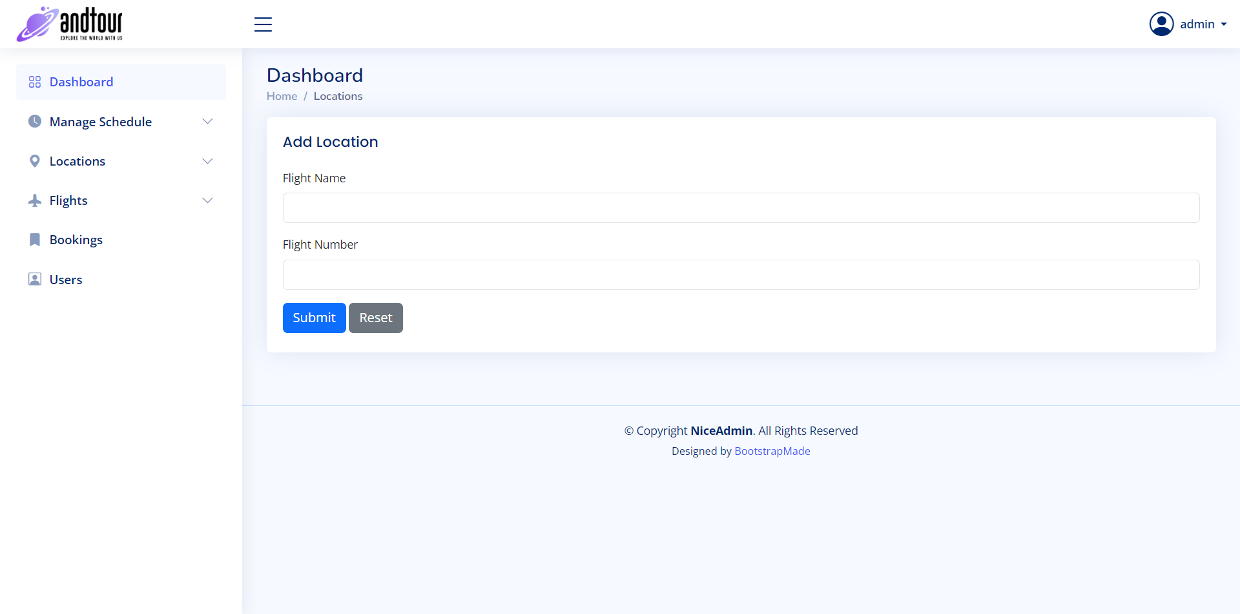
Add Location

Slide 14
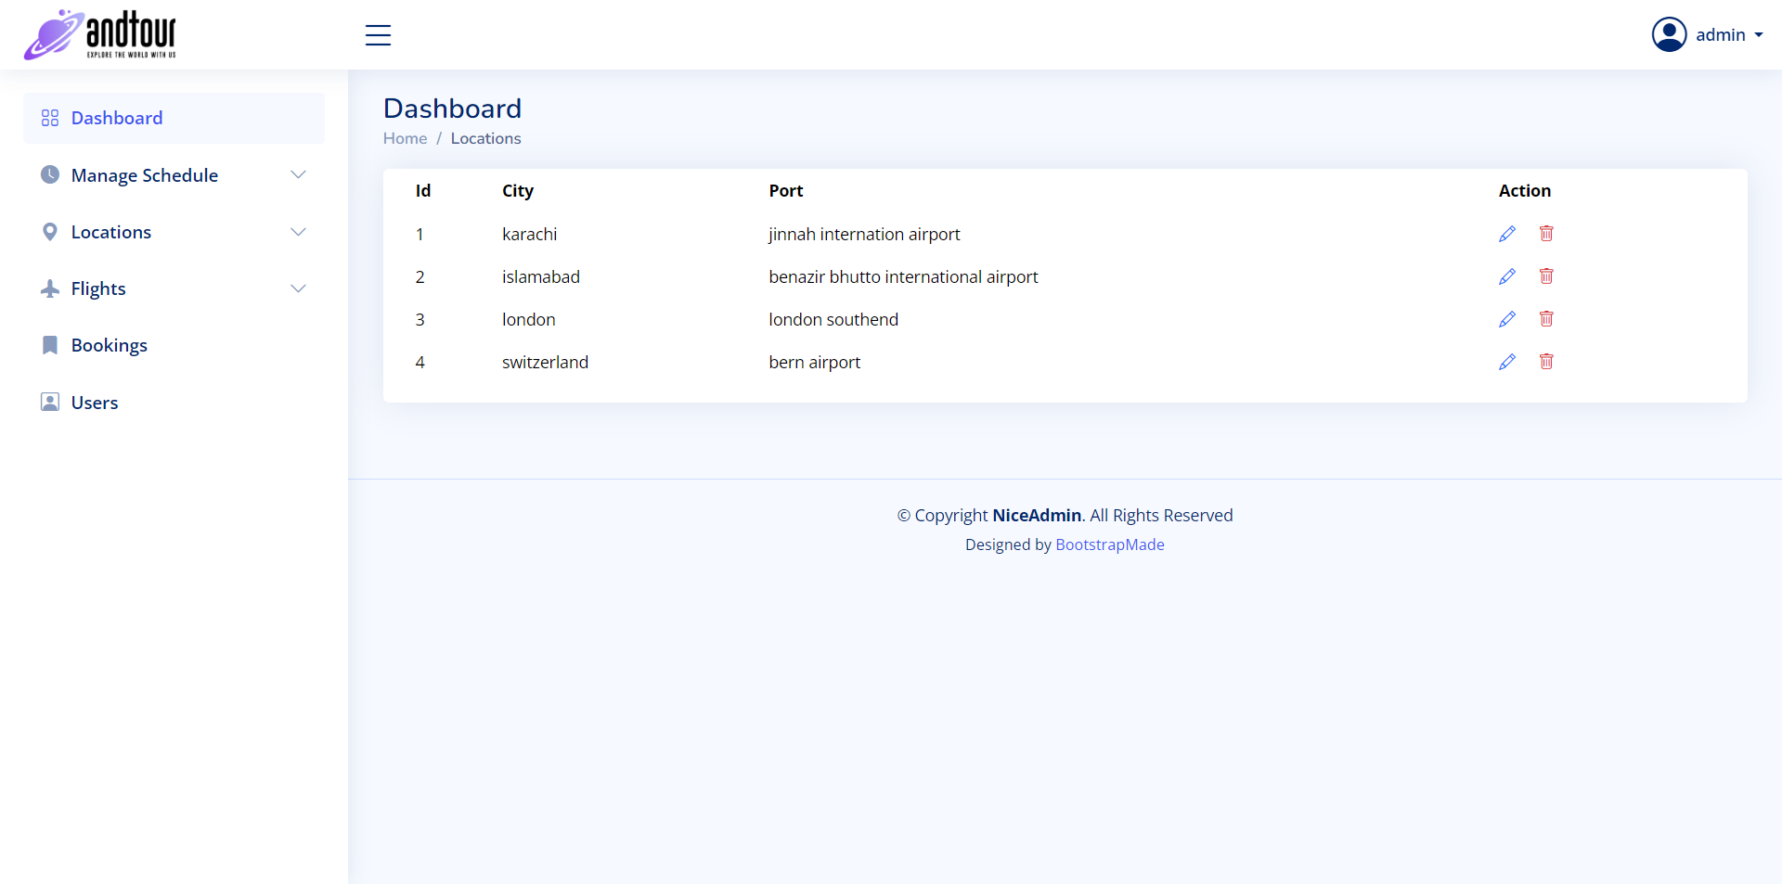
All Locations

Slide 15
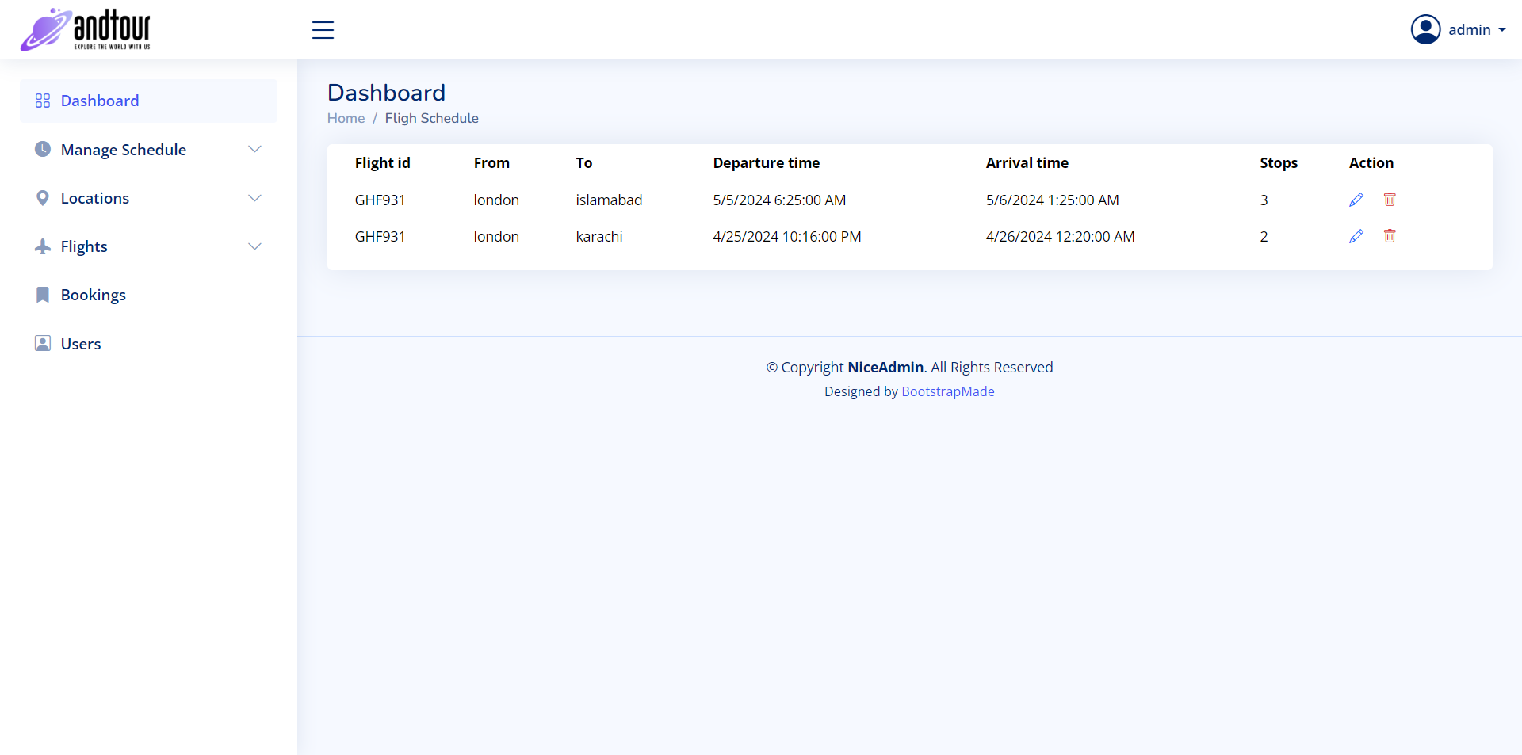
Scheduled Flights

Slide 16
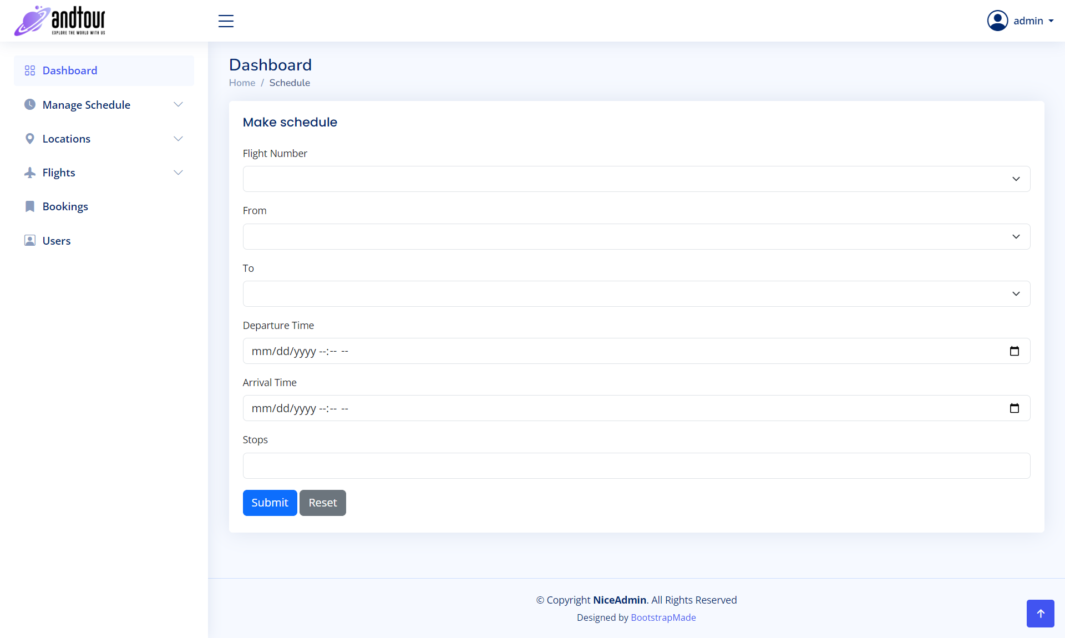
Schedule a New Flight

Slide 17
Thanks

